Slide 1
UX Fundamentals
The Skeleton Plane

Slide 2
The Five Plane Model
Strategy
Scope
Structure
Skelton
Surface
Abstract
Concrete
Notes:
Developed by Garrett Jessie James, the five plane model is a UCD approach very will suited to understanding good UX principles. It builds five planes of activity into the development process for UX starting from the most abstract user centred to a working prototype at the end of development.

Slide 3
The skeleton plane defines the form and functionality
  Addressing more concrete issues of presentation at an abstract level
    The high fidelity nature of colours etc… occur in the surface plane
The skeleton is defined through:
  Interface design – buttons, fields, and the like
  Navigation design – effective journeys through the application
  Information design – presentation of information in layout
These areas are linked together but best considered separately
  Then linked together
The Skeleton Plane

Slide 4
In this section we will examine:
Interface Design
Navigation
Information Design
Wireframes

Slide 5
Navigation

Slide 6
Navigating Multiple Screens
Allows large amounts of data to be displayed without the user navigating to it from another application
Decisions can be made with multiple sources of information displayed without obscuring each other, or breaking the user’s flow
Notes:
Multi-screen or multi-monitor setups are a boon to user productivity as they allow for data to be displayed on a separate monitor that is independent of what is being worked on but important for helping the user make important decisions without navigating away from where they are.

Slide 7
Navigating Multiple Views or Pages
Navigating among multiple application views or pages is disorienting for the user
Usually results in obscuring information in order to display the different page or view

Slide 8
Navigation Between Tools and Menus
Tools that are used frequently and in conjunction with each other should be grouped together
Commonly used functions should be provided in toolbars or palettes rather than in a menu where they cannot be seen prior to clicking
Menus should be used for infrequently accessed commands

Slide 9

Scrolling is often necessary, but attempts should be made to minimise the need for it whenever possible
Linking is the predominant navigation method of the web, but requires care to be taken to ensure that visual and textual clues are provided for the user to be oriented
Zooming and panning are particularly useful in 3D navigation, but are less useful when examining arbitrary or abstract data provided in more than two dimensions
Users find panning and zooming to be difficult to navigate unless the idiom supports the concept
Navigating Information
Notes:
Users find panning and zooming to be difficult to navigate unless the idiom supports the concept
Maps are one area where they understand the concept

Slide 10
Improving Navigation
Reduce the number of places to go
Provide signposts and overviews
Provide appropriate mapping of controls to functions
Avoid hierarchies
Notes:
Provide appropriate mapping of controls to functions
Gas cookers are usually terrible at this; at best they give you an idea which half of the stove the gas burner you are turning the knob for will be located

Slide 11
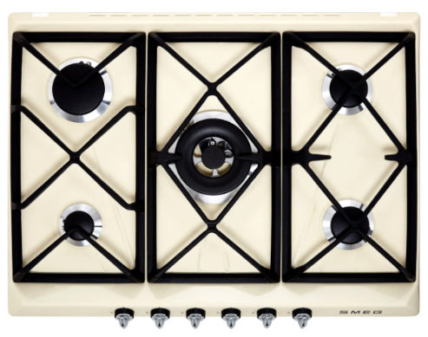
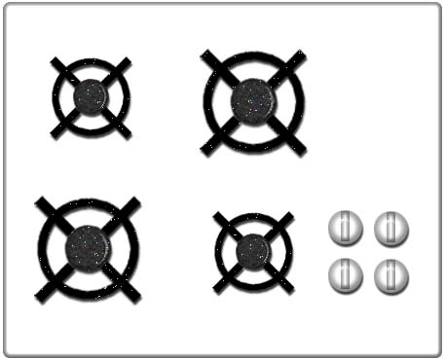
Natural Mapping
Notes:
Gas hobs typically have very poor natural mapping. In the example on the left, it would be very hard to determine which knob controls the different gas heaters, without looking at labels or diagrams.
In the example on the right, natural mapping has been used, and it would be much easier for the user to ascertain which knob controls the different heaters.

Slide 12
Sitemaps allow us to pull together the structure of a website/app
  It shows the structure of the site and how pages link together
  It is a to-do list showing what wireframes need to be constructed
  It can be used to ratify content strategies and user journeys
A sitemap lays out the key pages of a website - not the whole site
  Full scale maps go out of date very quickly
  The sitemaps shows the main structure of the website
They aid UX analysis in the following ways:
  Current content audits
  When structure needs to be reviewed and improve
  When creating a new website
Sitemaps

Slide 13
A sitemaps shows the pages that support the user goals
  Plus the pages necessary to support the business goals
A sitemap needs to show the structure of the key pages
  Plus navigation patterns to be applied
We can use data previous applied in analysis (e.g. card sorts)
  To identify labels and nomenclature
A sitemap is an important document for the designer/developer
  It layouts out documents to be taken to wireframe
Sitemaps Communicate User Goals

Slide 14
WHO NEEDS SITEMAPS?
Sitemaps benefit a number of technical roles in UX development:
  Designers
    A sitemap shows what wireframes/mockups need to be produced
    It can guide where templates and widgets should be constructed
  Content Teams
    Content teams need to know what is to be produced
    It can work with a content mapping strategy to create more content
  SEO Teams
    SEO teams need to know structure to advise on strategy
  Project Managers
    PMs can use a sitemap to understand high level structure
    While not overwhelming with content

Slide 15



Sitemap Elements
Page labels
Cross links
Pages with missing content
Page group outline
First
level
First
level
First
level
Header links
Second level
Second level
Second level
Third level
Third level
Third level
Logged in area
Fourth level
Fourth level
Fourth level
Other page types
Connectors
PDF download
Send text message
Send Email
Cross link

Slide 16
Example - Clothing Site
Header links
Home
Search
Help
Basket
Shirts
Jacket
Pants
Shoes
Summer wear
Request a catalogue
Email newsletter
T-shirts
Ski jackets
Jeans
Smart shoes
T-shirts
Shirts
Light jackets
Chinos
Boots
Shorts
Formal
Rain jackets
3/4 lengths
Trainers
Sunglasses
Casual
Leather jackets
Shorts
Hats
Polo shirts
Vests
Cross link

Slide 17
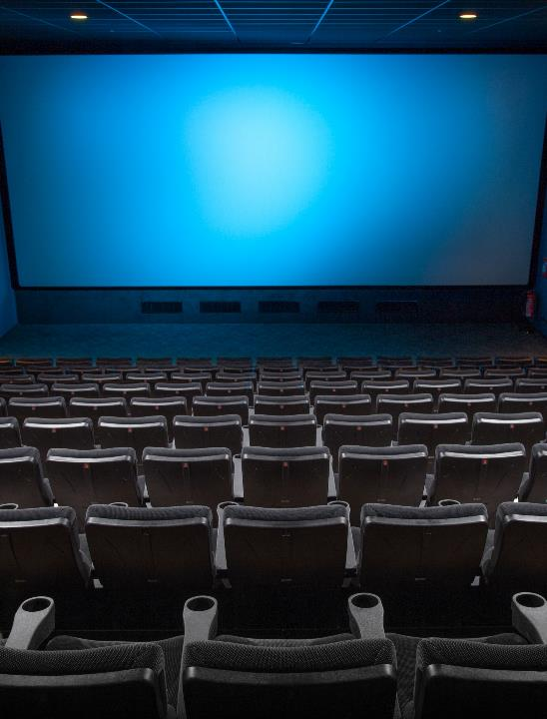
Activity: Implementing a Sitemap
Using the evidence from our card sorting investigation earlier, create a simple Sitemap for the cinema website.
Identify template/repeating links and the structure of the navigation.
Consider where some links and user journeys may overlap.

Slide 18
Designing Interactions

Slide 19


Understanding the Design Principles
Interaction design is not guesswork
User Interfaces should be based on user mental models rather than implementation models
Goal-directed interactions reflect user mental models
Significant Change must be Significantly Better

Slide 20

Understanding the Design Principles
Nobody wants to remain a beginner
Optimise for intermediate users
Imagine that your users are very intelligent, but extremely busy
Do not make the user feel stupid

Slide 21
Behaviour and Form
Optimise sovereign applications for full-screen use
Sovereign interfaces should feature a conservative visual style
Maximise document views within sovereign applications

Slide 22
Behaviour and Form
Transient applications must be simple, clear, and to the point
Transient applications should be limited to a single window and a single view
An application should launch to its previous position and configuration
Kiosks should be optimised for first time users

Slide 23
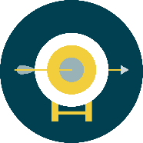
Behaviour and Form
No matter how impressive your interface is, less of it would be better
Follow users’ mental models
Less is more
Keep tools close at hand

Slide 24
Behaviour and Form
Let the user stay in control
Provide modeless feedback
Design for the probable but provide for the possible
Contextualise all information
  Only display the information if it’s relevant to the current situation
Notes:
Modeless – a communication with the user that they do not have to close it in order to use the application or the document in the background.
For example, in Microsoft Word press CTRL & H to display the Find and Replace dialog box. Notice that you can click back into your document without needing to close this dialog box.
Modal – a communication with which the user needs to close in order to continue (e.g. click on the OK button).
This is the more common type of dialog box within applications. For example, in Microsoft Word press CTRL & D to display the Font dialog box. Notice that if you try and click into the document the dialog box will flash, a sound will be made – you cannot interact with the application while a Modal type dialog box is on the screen.

Slide 25
Interaction Details
An error may not be your fault, but it is your responsibility
Have a good reason for going to a dialog box
  Do not use dialogs to report normality
Provide functions in the window where they are used
Use links for navigation and buttons for actions

Slide 26
Interaction Details
Disable menu items when they are not applicable
Use consistent visual symbols
Make all actions reversible

Slide 27
Interaction Flow

Slide 28



What is Flow?
When users are able to concentrate wholly on an activity, they lose awareness of peripheral problems and distractions.
It is a “condition of deep, nearly meditative involvement”
When a user is in a state of flow, they can be extremely productive
Flow: The Psychology of Optimal Experience by Mihaly Csikszentmihalyi
Peopleware: Productive Projects and Teams by Tom DeMarco and Timothy Lister

Slide 29

Flow
As the user is more productive, it is desirable to ensure that nothing distracts them or breaks their “flow”
Remember:
No matter how fancy your interface is, less of it is better
Less is more
Follow users’ mental models
Keep tools close at hand

Slide 30


Flow
Provide feedback that does not rely on modal dialogues
Design for the probable, as well as providing for the possible
Contextualise information
Avoid unnecessary reporting

Slide 31
Flow
Do not use dialogs to report normal results or activity
Avoid providing the user with a blank slate
Provide choices rather than asking questions
Optimise for responsiveness: nothing breaks flow like poor performance

Slide 32
Wireframing

Slide 33
A blueprint of schematic that represents the skeletal framework of a website or application
What is a Wireframe
It is created as part of a design process to help arrange elements in a design
It depicts a layout or arrangement of content, interface elements, and navigation systems and how they interact with each other
Most will lack any visual similarity to the look and feel of the end product
Notes:
A wireframe is a blueprint or schematic that represents the skeletal framework of a website or application. They are created as part of any design process to help arrange elements to best serve a chosen purpose as defined by the specifications laid out for the project.
It depicts a page layout or arrangement of the content, interface elements (widgets etc.) and navigation systems, and how they interact with each other.
Most will lack any visual resemblance to the end product in their look and feel, as the purpose is to focus on the functionality, behavior and hierarchy rather than what it looks like.

Slide 34
Wireframes can simply be pen/pencil drawings
They can be produced by a wide range of software applications
They are not beholden to any particular platform or medium
What is a Wireframe
Notes:
Wireframes can be pen and pencil drawings on paper or a whiteboard, or they can be produced by a wide range of software that range from specialist applications such as Axure or Omnigraffle, to illustration applications such as Photoshop or Illustrator.

Slide 35
The Focus of a Wireframe
Type of information displayed
Range of functions available
Relative priorities
Rules of information display
Notes:
They focus on
The type of information displayed
The range of functions available
The relative priorities of the information and functions
The rules for displaying different types of information
the effect of different scenarios on the display

Slide 36
Types of Wireframe
Low fidelity
  Rough sketches or mock-ups that are quick to produce with low levels of detail
High fidelity
  Higher level of detail, suitable for use in project documentation
Notes:
Different types of wireframes
Low fidelity
Sometimes referred to as “Scamps”
These are rough sketches or quick mockups that have little detail and are quick to produce. These wireframes are more abstract, allowing the project team to collaborate more quickly. They use simple shapes such are circles and rectangles with labelling to represent content, or may include dummy or symbolic content to represent data which is unavailable.
High fidelity
These incorporate a higher level of detail, this take longer to create. These are usually what you will see in project documentation, as the level of detail more closely resembles the design of the final product.
For simple or low-fidelity drawings, paper prototyping is a common technique. Since these sketches are just representations, annotations—adjacent notes to explain behaviour—are useful. For more complex projects, rendering wireframes using computer software is popular. Some tools allow the incorporation of interactivity including Flash animation, and front-end web technologies such as, HTML, CSS, and JavaScript.

Slide 37
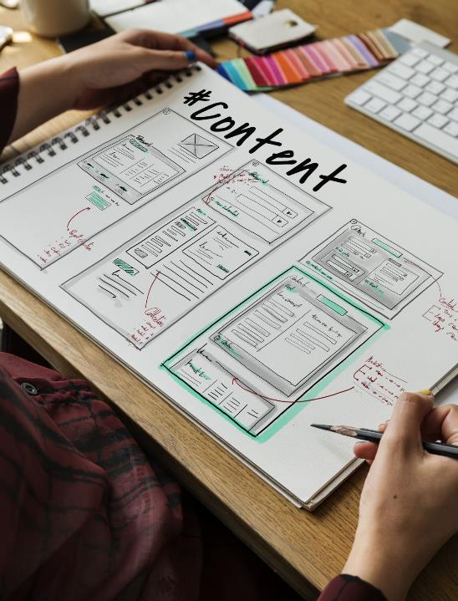
Elements of a Wireframe
The structure of an application can be broken down into three components
  Information design
  Navigation design
  Interface design
Wireframing is what depicts the relationship between these components
Notes:
Elements of a Wireframe
The skeleton plan of an application can be broken down into three components: information design, navigation design, and interface design. Page layout is where these components come together visually, while wireframing is what depicts the relationship between these components
Information Design
Information design is the presentation—placement and prioritization of information in a way that facilitates understanding. Information design is an area of graphic design, meant to display information effectively for clear communication. Information elements should be arranged in a way that reflects the goals and tasks of the user
Navigation Design
The navigation system provides a set of screen elements that allow the user to move page to page through a website or application. The navigation design should communicate the relationship between the links it contains so that users understand the options they have for navigating the site. Often, websites contain multiple navigation systems such as a global navigation, local navigation, supplementary navigation, contextual navigation, and courtesy navigation.
Interface Design
User interface design includes selecting and arranging interface elements to enable users to interact with the functionality of the system. The goal is to facilitate usability and efficiency as much as possible. Common elements found in interface design are action buttons, text fields, check boxes, radio buttons and drop-down menus

Slide 38
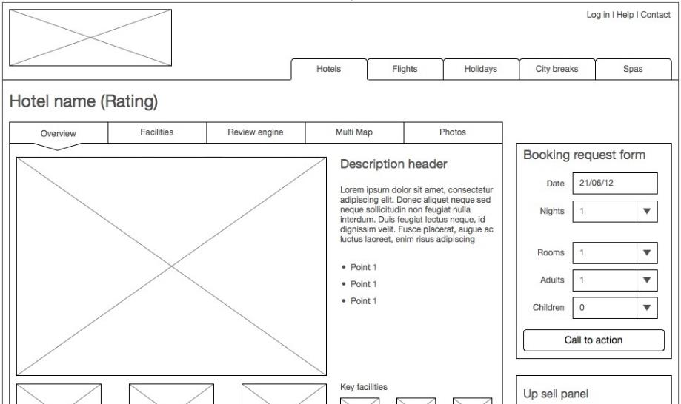
Low Fidelity Wireframe Example
Notes:
When it comes to wireframes, whilst there are common solutions, it usually comes down to boxes and labels.
Any labelling or marking is to aid in instant recognition of what you are representing. As long as you visually convey your message, it does not matter what symbols you are using.

Slide 39
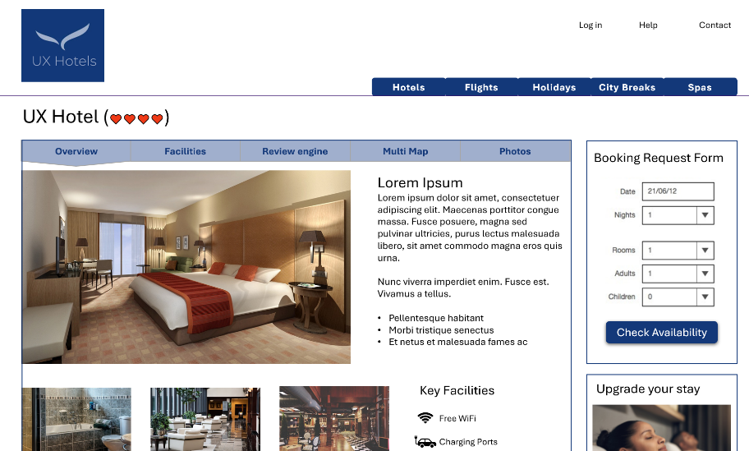
High Fidelity Wireframe Example

Slide 40
The Language of Wireframing
Text
Graphic Elements
  Any artwork that is displayed
Widgets
  Any control or GUI element that displays information that is changeable by the user
Notes:
Text
Self explanatory
Graphic Elements
Any artwork that is displayed. This includes icons, pictures, and textures
Widgets
A GUI widget or control is an element of a graphical user interface (GUI) that displays information that is changeable by the user, such as a window or a text box. The defining characteristic of a widget is to provide a single interaction point for the direct manipulation of a given kind of data. i.e. widgets are basic visual building blocks which, combined in an application, hold all the data processed by the application and the available interactions on this data.

Slide 41
The Language of Wireframing
Icons
  A pictogram Graphic Element that is displayed to help the user navigate the system, or understand the data presented
  They are designed to be easily comprehensible and as such are stripped of extraneous detail
Alignment grids
  A set of invisible lines that content is “snapped to”
  It is a way of reducing visual clutter, creating clean and evenly spaced layouts, and maintaining coherency across a product or product line
Notes:
Icons
A pictogram Graphic Element that is displayed to help the user navigate the system, or understand the data presented.
They are designed to be easily comprehensible and as such are stripped of extraneous detail.
Alignment grids
A set of invisible lines that content is “snapped to”
It is a way of reducing visual clutter, creating clean and evenly spaced layouts, and maintaining coherency across a product or product line.

Slide 42
Activity: Low Fidelity Wire Frame
Take 15 minutes and prepare a single low fidelity wireframe on the whiteboard as a group.
This should be for one of the following pages:
  Booking a ticket
  Ordering food
  About Us
  Coming Soon
Notes:
There should be a single wireframe, that includes concepts on navigation and interaction.
If the candidates look like they are splitting off into separate groups, nudge them back together; they are working on the wireframe as a whole, and doing it as a group.
If they are presenting different wireframes, tell them to pick the elements that they like, and work it into the main wireframe.
Encourage them to erase, revise, and iterate on the whiteboard; you want them to get used to a dynamic design session where it is about throwing ideas out and seeing what does and does not work. Remind them that there are no bad ideas; only ideas that aren’t right for *this* scenario, and that they will get better results by throwing those ideas up, and discarding them later than if they thought about them before they threw them up there.

Slide 43
Activity: High Fidelity Wire Frame
Take 15 minutes to design a higher fidelity wireframe for the cinema website home page.

Slide 44
Interactive Prototypes
Interactive prototypes are usually built as a series of HTML pages
They are usually reserved for higher level Wireframes to be used for user or usability testing, or to impress stakeholders
See Also: Rapid Prototyping
http://www.uxforthemasses.com/rapid-prototyping/
Notes:
You’re probably thinking “Why can’t I do this as a series of web pages?” since it’s a fairly straight forward set of static designs that are navigated through containing mainly boxes and text.
The answer is that you can.
In fact, this is what most interactive prototypes are; a set of static html pages that can be navigated through to simulate the application.
If your end product is in HTML/CSS you may even find yourself building on your wireframes, adding more detail and refinement until they have been transformed into a releasable product.
Also known as Rapid Prototyping, this is the current trend for replacing the High-Fidelity wireframes, as it is easier to maintain, more user friendly, and much quicker to create.

Slide 45
The skeleton Plane is where a digital product takes shape
  Its aim is to map user goals and stories into pages/screen
  Your project will consider and implement a navigation strategy
Remember to reinforce the structure through the user focused evidence
Review

